Slide 1
CSE 6324 – ITERATION 1
TESTING AUCTION SMART CONTRACTS FOR ETHEREUM VIRTUAL MACHINE
Prepared By: Team 9
Venkata Ashok Sairam Dasari – 1002029845
Mithun Ekanandan – 1001843906
Vankireddy Karthik Reddy - 1002038114
Teja Sankara - 1002033648

Slide 2
Introduction
Auction smart contract allows bidding and closes the auction in a specific time.
Avoids third party auctioneer.
Allows multiple users to place bids and the highest bidder is the winner.
Entire process is trustless and Secure.
Fuzzing tool will be developed to test Auction Smart contracts.

Slide 3
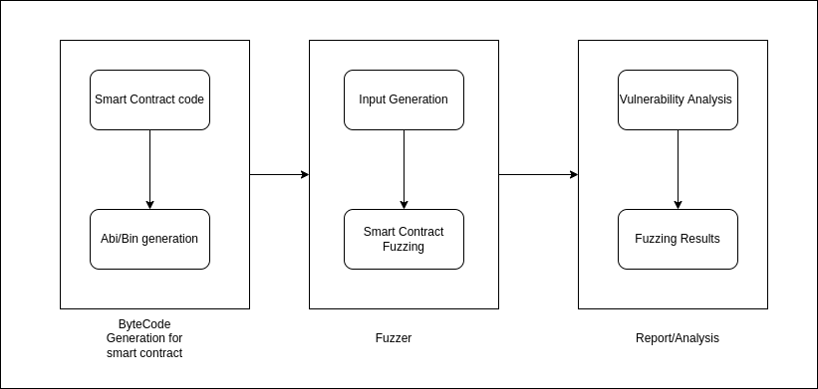
Architecture

Slide 4
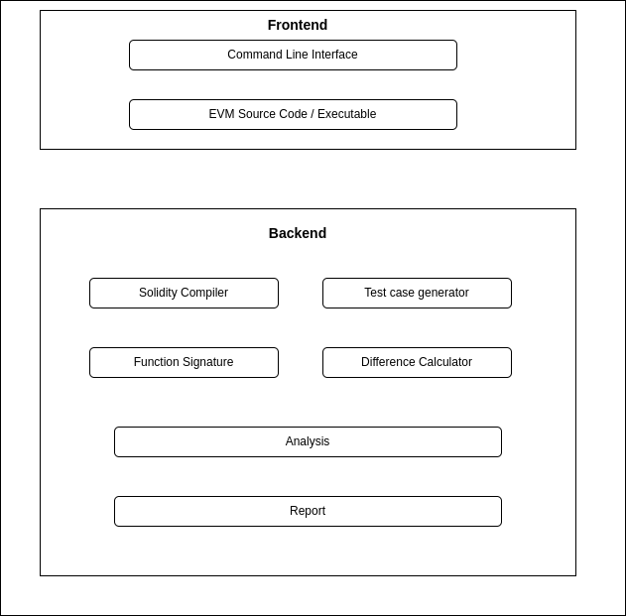

Slide 5
Iteration 1 Implementation
Upskilled in new technologies
Implemented smart contract code for Simple Auction and Dutch Auction[2] .
Implemented code for Mail delivery of reports[2] .

Slide 6
Auction Smart Contract Vs Dutch Auction Smart Contract
Normal Auction: Highest Bidder Wins in Normal Auction.
Dutch Auction: Price goes down by certain percentage over time.
Minimum price Vs Start Price (Maximum price).

Slide 7
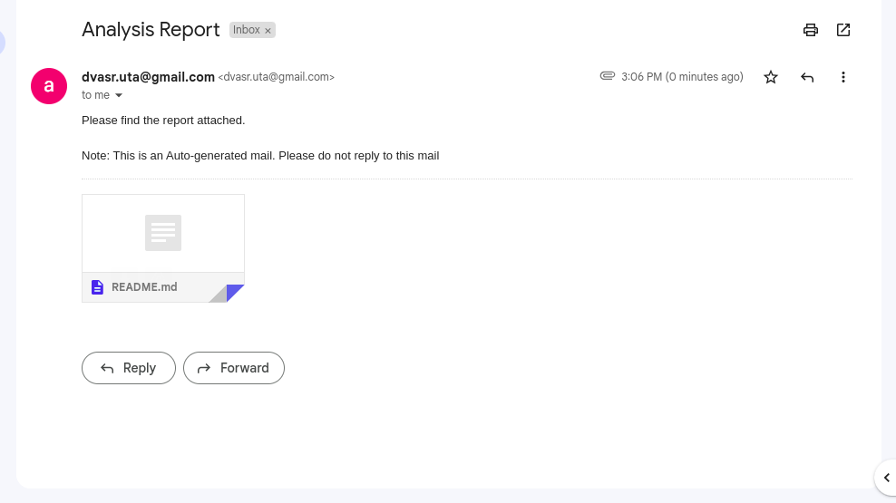
Report Delivery through mail

Slide 8
New Risks
False Negative Vulnerabilities.
Faulty EVMs [1].

Slide 9
Plan for Iteration 2
Basic Implementation of tool should be in place.
Basic fuzzing tool to be developed to test simple smart contracts.

Slide 10
References
[1] Ying Fu, Meng Ren, Fuchen Ma , Heyuan Shi , Xin Yang , Yu Jiang , Huizhong Li , Xiang Shi. 2019. EVMFuzzer: Detect EVM Vulnerabilities via Fuzz Testing
[2] https://github.com/ashokdv/CSE-6324-Smart-Contractzs-for-EVM

